Slide 1
Internet of Things Security - Multilayered Method For End to End Data Communications Over Cellular Networks
ABHISHEK J.M & ASHISH K.P
III Semester ISE
J N N C E SHIMOGA

Slide 2
This paper coverS
WHAT IS AN IOT?
INTRODUCTION
THE MULTILAYERED METHODOLOGY
ARCHITECTURAL SYSTEM DESCRIPTION
THE INTERLOCKING FUNCTIONAL ELEMENTS
CONCLUSION

Slide 3
WHAT IS AN IOT?
Today Internet applications demand is very high. So IOT is a major technology by which we can produce various useful internet applications.
IOT is a very good and intelligent technique which reduces human effort as well as easy access to physical devices. This technique has autonomous control feature by which any device can control without any human interactions.
With the explosive growth of Internet of Things (IOT) solutions comes the greater concern over security issues associated with the plurality of devices being connected. It is projected that the growth in Internet of Things connected devices will exceed 20 Billion devices by 2020.

Slide 4
INTRODUCTION
AS THESE DEVICES UTILIZE CELLULAR CONNECTION CONNECTIVITY TO INTERCONNECT;
Poorly Architected cellular connectivity can open the solution to potential security issues.
A highly secured architectural solution requires a good multilayered security approach encompassing the overall architectural design for connectivity.
Alternatives to cellular connectivity include solutions that may utilize Ethernet or wireless Wi-Fi and depend upon the public Internet for transport of data from the edge device to the host. These alternative solutions present a number of security vulnerabilities.

Slide 5
A MULTILAYERED METHODOLOGY
The multilayered methodology described here provides a secure wireless connection utilizing packetized data as found in 3G and above cellular carrier technology to establish a robust connection between the IOT device and the backend host for bidirectional communications.
It consists of interlocking functional elements they are;
SIM based authentication and key agreement.
Radio access network encryption,
Custom access point name (APN),
Private non-routable TCP/IP addressing,
Non-split tunnel routing schema,
Point to point data transport to host,
Destination host router monitoring,
No direct device to device communications,
SIM v toolkit IMEI alidation and alerting,
PIN locking of SIM

Slide 6

ARCHITECTURAL SYSTEM DESCRIPTION
Simplified end to end architecture for connecting IOT wireless devices to a destination host.
This fig shows a highly simplified diagram of the architecture described in this paper. The IOT cellular device is connected to the local serving cell tower via an encrypted radio access network. The local tower is securely connected to the home carrier’s mobility data center. The destination host is connected via a point to point encrypted link.

Slide 7
ARCHITECTURAL SYSTEM DESCRIPTION
TWO INHERENT BENEFITS OF THIS ARCHITECTURE;
Leveraging standards-based elements so that the solution may be applied to off-the-shelf IOT devices.
End-to-end security, which is achieved without a costly over-the-top data encryption from the device to the host.
While encrypting the data stream prior to leaving the edge device and un encrypting at the host does provide an extra layer of security, it typically comes at the cost of higher data throughput which in the cellular space is metered per byte or kilobyte.
The secure architecture provides a suite of satisfactory security interlocking functional elements that properly combined can prevent unauthorized access to the data channel.

Slide 8
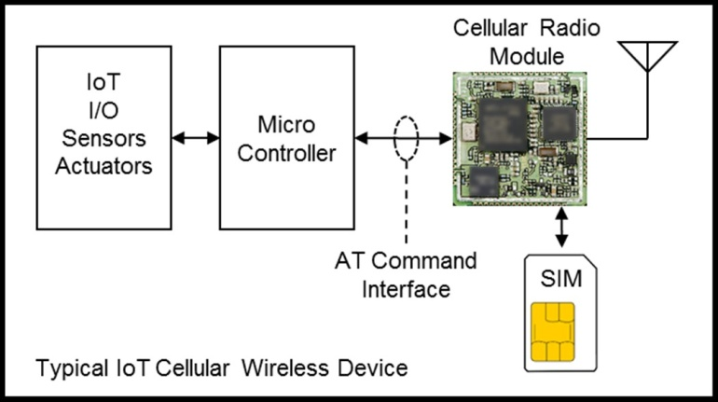
THE INTERLOCKNG FUNCTIONAL ELEMENTS.
SIM-BASED AUTHENTICATION AND KEY AGREEMENT.
Fig. 2. Typical IOT wireless device components highlighting SIM connectivity to the Radio Module and the AT command interface where radio chip set probe information is exchanged.

Slide 9
SIM BASED AUTHENTICATION & KEY AGREEMENT.
The SIM’s basic function is to protect Authentication keys from being compromised.
The SIM consists of a microprocessor that incorporates a number of hardware protection technologies to prevent compromise through chemical decomposition, x-ray or any number of attempts to reverse engineer.
Additionally, protection procedures are applied to the I/O pins of the SIM to prevent forced external anomalies from rendering the SIM vulnerable to compromise.
For instance, inducing a higher or lower voltage on the TX and RX pins in reference to the supply and ground in an effort to cause the I/O circuitry to latch up or go into an unintended state is monitored by the SIM I/O circuitry and will disable the SIM if these conditions exist.
The SIM is also protected against anomalous clocking and input data.

Slide 10
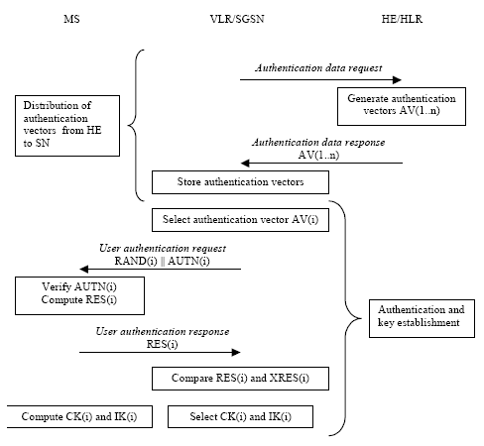
AUTHENTICATION & KEY AGREEMENT
The authentication and key agreement mechanism diagrammed in Fig. 3, utilizes a secret key K which is known only to the SIM and the Internet of Things home carrier .
The SIM provides a very secure method to authenticate an IOT device even before the data link is established. The SIM also plays a role in several of the other security functional elements as articulated next.
There are many methodologies in place, not addressed in this paper, to ensure that the Internet of Things device uses the desired radio carrier to attach to.

Slide 11
Radio Access Network Encryption
B. RADIO ACCESS NETWORK ENCRYPTION:
An additional security element as part of the overall data transport security methodology is that the radio link layer between the IOT device radio module and the cellular tower is 128-bit encrypted, utilizing the key from the previous section, as part of the standard GSM protocol for 3G and above transmissions.
END TO END ARCHITECTURE FOR CONNECTING IOT WIRELESS DEVICES TO A DESTINATION HOST.

Slide 12

THE INTERLOCKING FUNCTIONAL ELEMENTS
C. CUSTOM ACCESS POINT NAME( APN):
Once the Internet of Things device has authenticated, the microprocessor within the Internet of Things device can initiate a encrypted data for End to end error free transport. i.e TCP/IP.
APN is the name of a gateway between a ,3G,4G mobile network, frequently the public network. A mobile device making a data connection must be confiqured. The carrier will then examine this to determine what type of network to be created.

Slide 13
THE INTERLOCKING FUNCTIONAL ELEMENTS
D. PRIVATE NON-ROUTABLE TCP/IP ADDRESSING
In the Internet addressing architecture, a private network is a network that uses private IP address space. These addresses are commonly used for local area networks in residential, office & enterprise environments. Those are actually the authenticated networks.
E. NON-SPLIT TUNNEL ROUTING SCHEMA:
Poorly architected solutions often provision an APN to split the data packet tunnel. In other words, while the private data packets are directly sent to the enterprise customers as previously described, the public destined packets are directly
routed from the mobility data center off to the public Internet. While this is a possible architecture, it is one that breaks this security methodology because now an IOT device has a path to the public Internet that is not under the control of the enterprise customer.

Slide 14
THE INTERLOCKING FUNCTIONAL ELEMENTS
F. POINT TO POINT DATA TRANSPORT BETWEEN CELLULAR CARRIER AND HOST:
The point-to-point connection between the mobility data center and the destination host may take the form of an VPN tunnel. VPN generally utilizing Cisco firewall VPN equipment at both the carrier and the host data sites. Here all the encrypted data will be interacted privately to avoid the hostile attacks.
G. NO DIRECT DEVICE TO DEVICE COMMUINICATION:
It is interesting to note here that a commonly used term for IOT is Machine to Machine (M2M), creating the misconception that IOT devices talk directly with one another. The methodology as described in this paper prohibits direct device-to-device communications via the carrier or customer’s host router. In fact, IOT device communications are only routed to the application layer managing the IOT solutions within the backend host.

Slide 15
H.DESTINATION HOST ROUTER MONITORING
Another benefit of this secure routing schema is that all data packets to and from the IOT device passes through the enterprise customer’s router.
Deep packet inspection at the customer’s router can detect in real-time that abnormal data behavior is occurring from the IOT devices, which may indicate fraudulent or malicious activity.
Automated alarm is used when the system goes with some bias activities.

Slide 16
I.SIM TOOLKIT IMEI VALIDATION AND ALERTING.
Once the IOT device has established a secure connection between its radio module and its backend serving host, additional security is garnered in the form of physical protection. One method already described is the physical hardware security included in the SIM element to protect the encrypted keys held within.
And one more is referred to as the IMEI or international mobile equipment identifier. Each manufacturer of wireless devices after completing the required approval testing is assigned its own unique range of IMEI’s for its product.

Slide 17
J. PIN LOCKING OF SIM
The standard PIN locking functionality of the SIM is utilized by the IOT device as a security method.
The device manufacturer creates a secure hashing algorithm within the device processor’s the hashing algorithm to produce the 4 digit unlock code and passes to the SIM. If the code matches the SIM’s then the SIM is enabled for operation. If the pin does not match after 3 attempts, the SIM is rendered unusable or blocked.
There is an unblocking sequence using an 8-digit code known only to the device provider that can unblock a SIM and if that is incorrectly administered 10 times, the SIM becomes permanently inoperable.

Slide 18
CONCLUSION
This paper has set forth a multi-tiered solution for securely establishing end-to-end TCP/IP based Internet of Things communications over cellular-based networks. This methodology consists of standards based interlocking functional elements deployed in a securely architected carrier network providing a secure end to end communications channel for Internet of Things devices and applications.

Slide 19
FURTHER STUDY
In this paper, an introduction to IOT security over cellular networks is presented ,and point of the current research problems and research prospects hoping to provide a useful reference for the further study of IOT security for cellular devices.
REFERENCE
3GPP TS 11.113rd Generation Partnership Project; Technical Specification Group Terminals Specification of the Subscriber Identity Module - Mobile Equipment (SIM
- ME) interface
3GPP TS 22.022 3rd Generation Partnership Project; Technical Specification Group Services and System Aspects; Personalisation of Mobile Equipment (ME);
Mobile functionality specification
3GPP TS 23.122 3rd Generation Partnership Project; Technical Specification Group Core Network and Terminals; Non-Access-Stratum (NAS) functions related to Mobile Station (MS) in idle mode
3GPP TS 33.102 3rd Generation Partnership Project; Technical Specification Group Services and System Aspects; 3G Security; Security architecture
3GPP TS 21.111 3rd Generation Partnership Project; Technical Specification Group Core Network and Terminals; Universal Subscriber Identity Module (USIM) Application Toolkit (USAT)

Slide 20
THANK YOU
ASHISH K.P & ABHISHEK J.M

